Slide 1


DAB 402 CAPSTONE PROJECT Group 7
Group members
Abdul hannan
Amith John Varkey
Delta Joseph

Slide 2

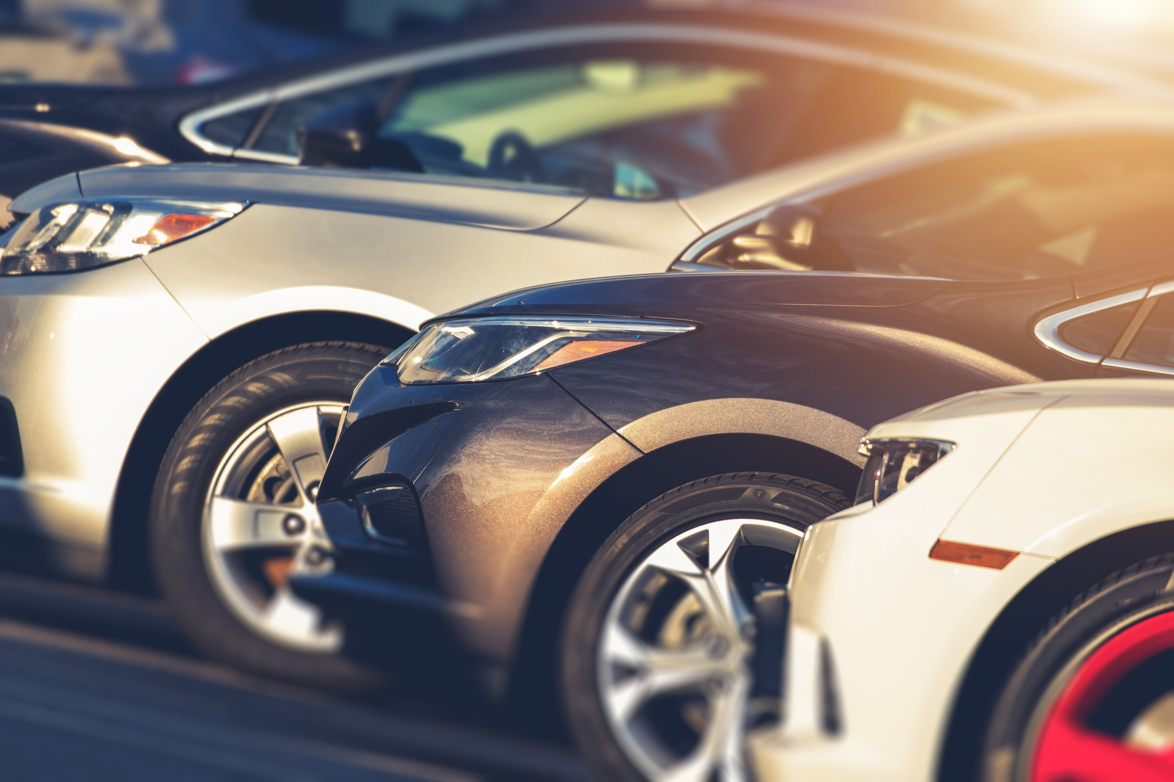
PRICE PREDICTION OF USED CARS USING DEEP LEARNING

Slide 3
OBJECTIVES
Introduction
Why we choose this topic?
Why Machine Learning?
About the dataset
Data Overview
Data Cleaning
Data Visualization
Models Implemented
Results
Conclusion
Challenges
Future Scope
Reference
Project Code Links

Slide 4
Introduction
Since transportation demand has an incredible increase over years ,the number of people relying on used cars had increased. In order to determine the resale value of vehicles, and in consideration with the future demand ,our team worked on the project “Price prediction of Used cars using deep learning”.
In this project we look at the application of supervised machine learning techniques to "Predict the price of used vehicles.
" The forecasts are based on historical data obtained from "Kaggle" and real-time data from "Automaxx" which is one of the pre-owned car dealers in Windsor.
Different approaches like machine learning models and deep learning were used in order to evaluate the models and thereby predict the price of used cars.

Slide 5

Why we chose this topic.?

Slide 6
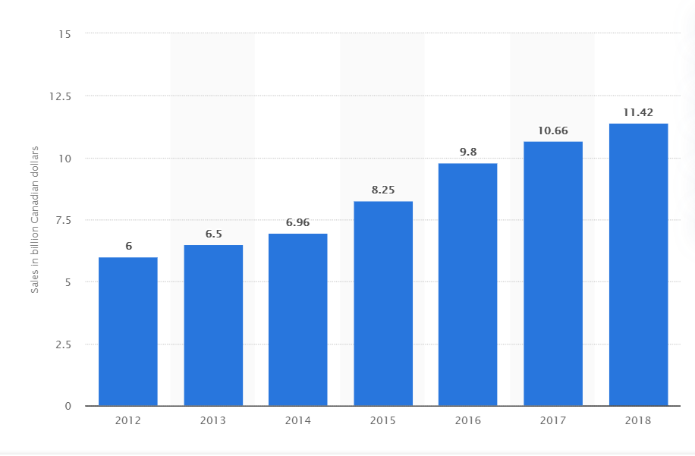
Retail sales of used car dealers in Canada from 2012 to 2018.
Source : https://www.statista.com/statistics/431937/retail-sales-of-used-car-dealers-in-canada/

Slide 7
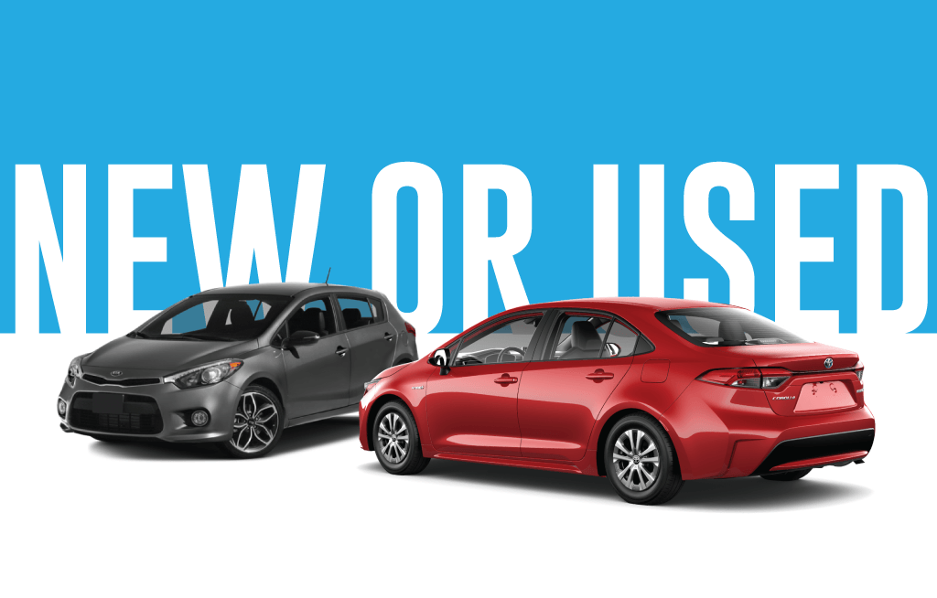
Source: https://www.humberviewgroup.com/guide/buying-used-car-vs-new-car/

Slide 8
Why Machine Learning.?
Traditionally car dealers uses manual prediction in order to predict the price of an used car to a customer.
But the problem related to this type of approach is that the price may be different for different car dealers.
In order to solve this, we use machine learning which helps to handle large amount of structured and unstructured data and will try to identify the hidden patterns in it.
So by this approach we will be able to find the actual base price of pre- owned cars. since we will be feeding all real time data continuously to the model.
Therefore the model can learn from itself each and every time.

Slide 9






Tools mainly used
Source: Google images
Source: Google Images

Slide 10

About the dataset
We got a real time data from one of the leading pre- owned car dealers in Windsor, that is “AUTOMAXX “.
This data consist of 200 rows and 10 columns which included make, model, year of manufacture, odometer range, VIN ( vehicle identification number) and all.
Since it only had 200 rows of data which is not at all a good number to do model building so we planned to move with other dataset to do model building.
Source: https://www.automaxxwindsor.com/?utm_source=Google&utm_medium=GMB&utm_campaign=GMB

Slide 11

Problem faced while collecting data.! And also the five C’s
Notes:
Source: https://www.google.com/imgres?imgurl=https%3A%2F%2Fmiro.medium.com%2Fmax%2F1000%2F1*3Dh8XRirCn48CsRp3m0uyA.jpeg&imgrefurl=https%3A%2F%2Fmedium.com%2F%40legalcalls%2Fquick-guide-to-maintaining-confidentiality-online-ada43fe52f27&tbnid=bn4cx79qpJJoQM&vet=12ahUKEwjxkPnN9NnnAhUD_qwKHf4MB8kQMygBegUIARCIAg..i&docid=wT45gA5eQd-2PM&w=1000&h=667&q=confidentiality&ved=2ahUKEwjxkPnN9NnnAhUD_qwKHf4MB8kQMygBegUIARCIAg

Slide 12
Our main dataset will be from the Kaggle website.
It consist of 2 dataset one for test and one for train. But in the test dataset, the price column ( that is our target column ) is having almost null values .
So we decided to work on only train data which consist of almost 6019 rows and 14 columns.
So after doing all the exploratory data analysis we will be splitting this dataset into test and train with test_size ratio(0.2&0.25).

Slide 13
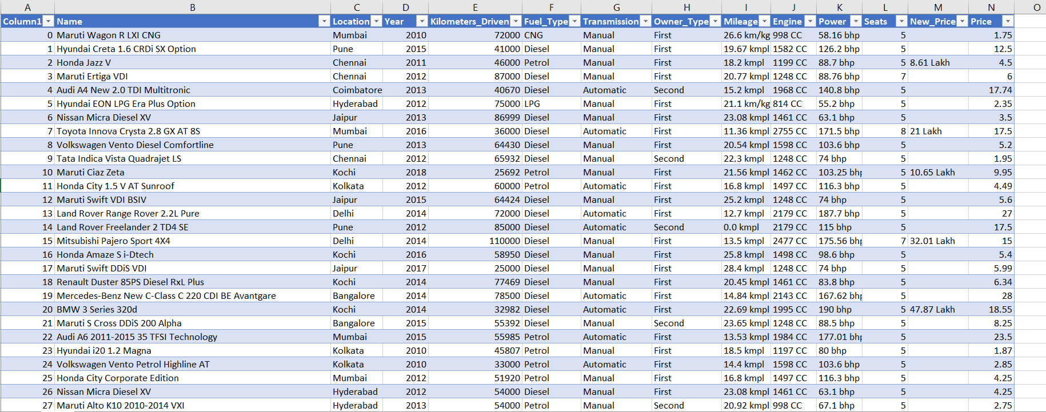
Main dataset

Slide 14
Data Overview
The following are the attributes:
Name : The brand and model of the car.
Location : The location where the car is being sold.
Year : The year of the model.
Kilometers_Driven : The total kilometres driven in the car by the previous owner.
Fuel_Type : The type of fuel used by the car.
Transmission : The type of transmission used in the car.
Owner_Type : Whether the ownership is first hand or second hand.
Mileage : The standard mileage offered by the car.
Engine : The displacement volume of the engine .
Power : The maximum power of the engine.
Seats : The number of seats in the car.
New_Price : The price of a brand new one of the same model
Price: The price of the used car.

Slide 15
Data Cleaning

Slide 16
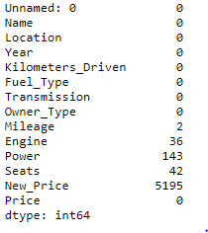
As you can see here, features like Mileage , Engine, Power, Seats and New Price were having null values.
So we imputed these values by taking the mean values for each features respectively and also taking the mode value for the feature Seats.
Here ‘Unnamed: 0’ and ‘New_Price’ features are of least importance so we decided to drop these columns.

Slide 17
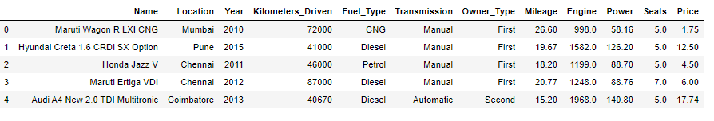
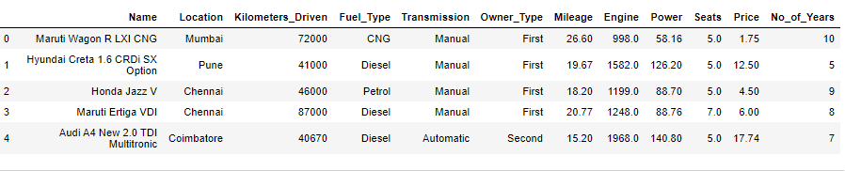
We have introduced a new column named 'No of Years' which reflects the difference between the current year and the year it was made.

Slide 18
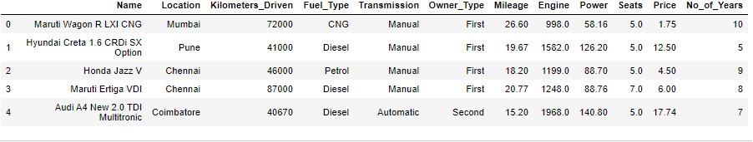
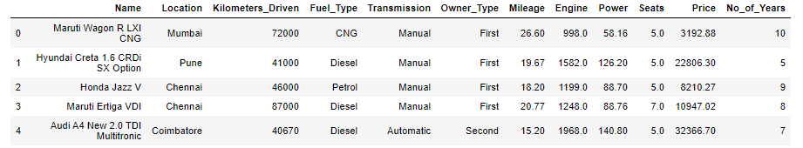

We also translated the lakhs (Indian currency) price column into CAD (Canadian dollar) by multiplying it with the current exchange rate.

Slide 19
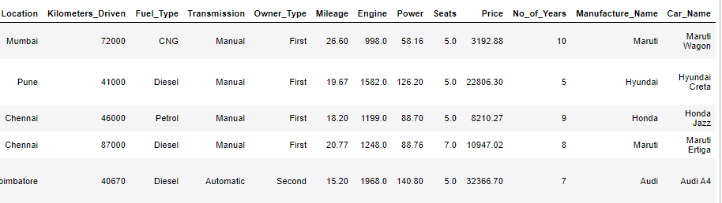
We also created two columns, ‘Manufacture_Name’ and ‘Car_Name’ which shows the company name and car name for each record respectively.

Slide 20

Data Visualization

Slide 21
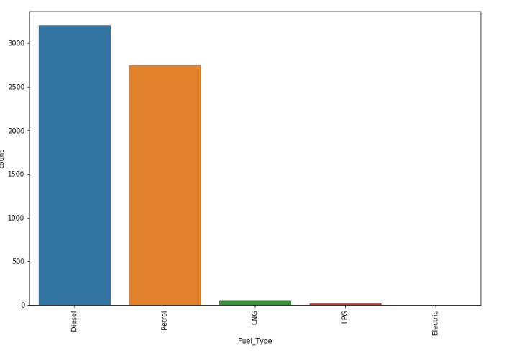
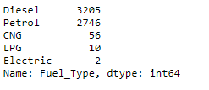
Histogram showing the count of records for different Fuel Types.

Slide 22
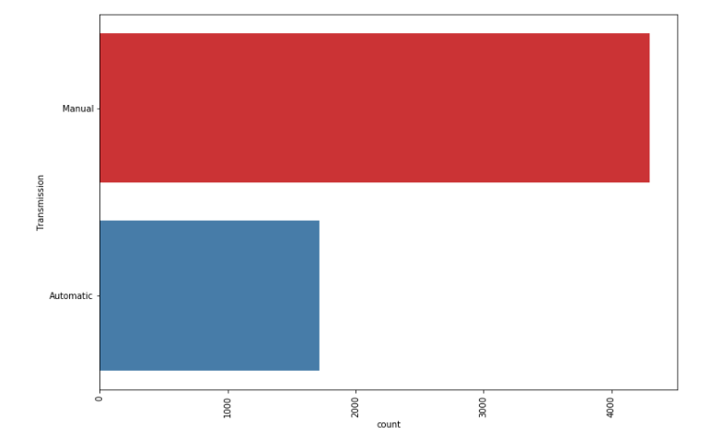
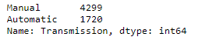
Histogram showing the count of records for different Transmission Types.

Slide 23
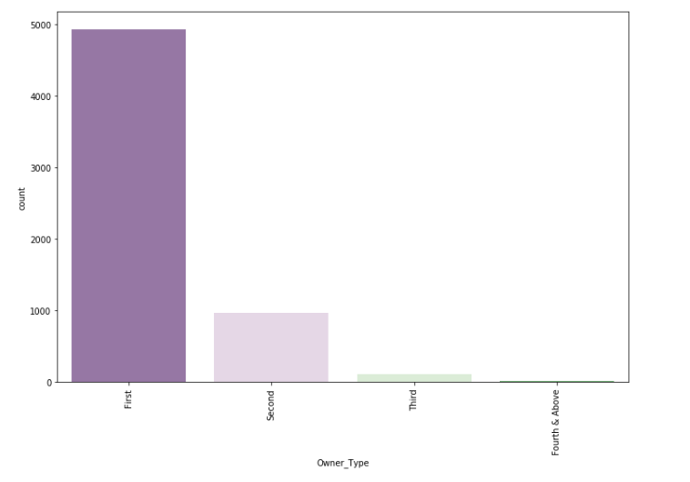
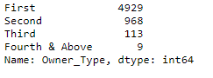
Histogram showing the count of different Owner Types.

Slide 24
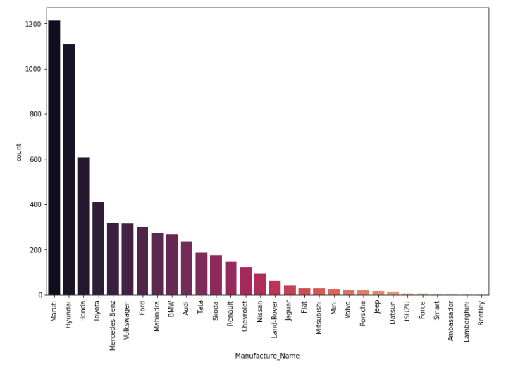
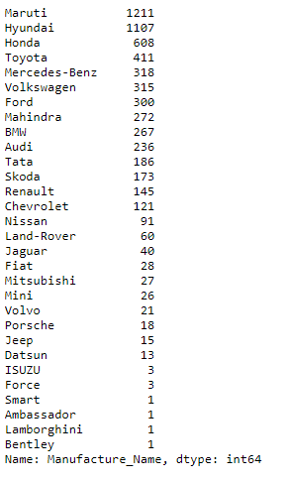
Histogram showing the count of records for different Car Company.

Slide 25
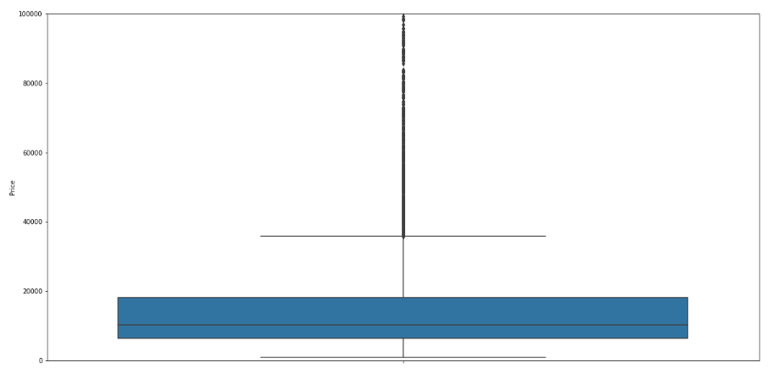
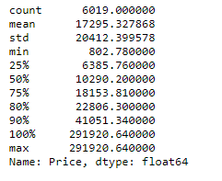

Box Plot for the Price column.

Slide 26
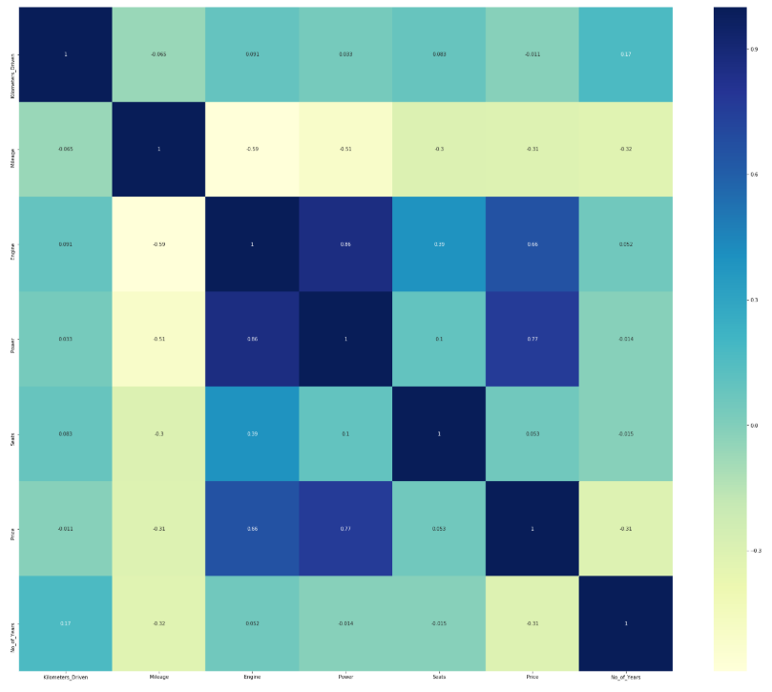
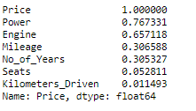
Correlation plot

Slide 27
Models Implemented
Linear Regression Model
K-Neighbours Regression
Decision Tree Regression
Random Forest
Gradient Boosted Regression Model
Ridge Regression
Lasso Regression
Neural Network (Keras)
XGBOOST Regressor with 5 folds

Slide 28
Results

Slide 29
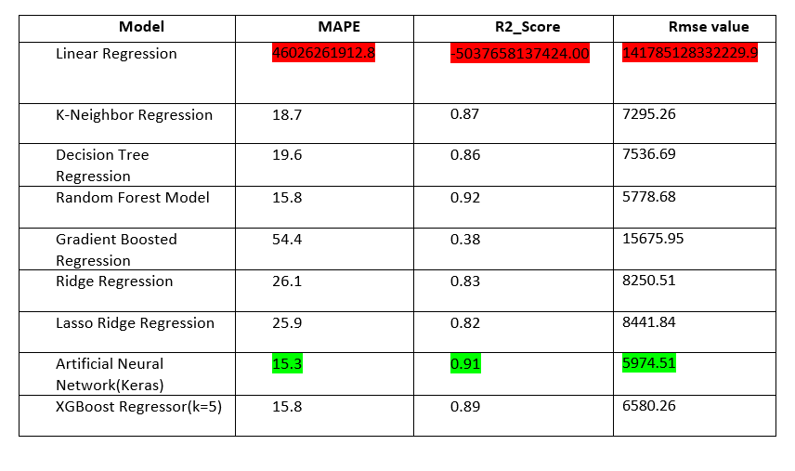
With Test size = 0.2

Slide 30
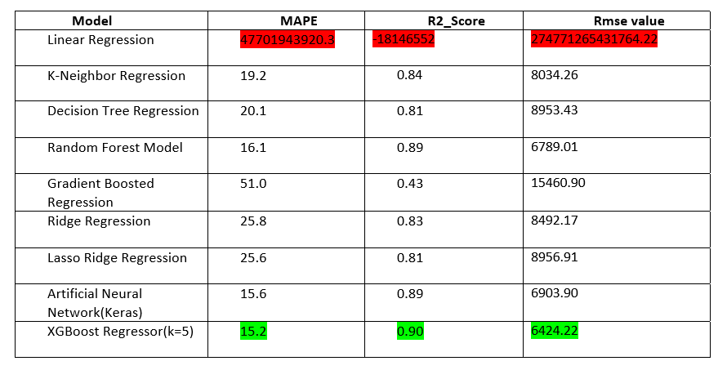
With Test size = 0.25

Slide 31
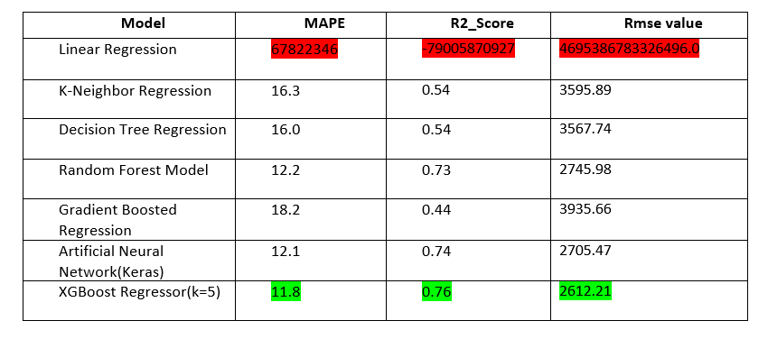
Modelling done on the Automaxx data.

Slide 32
Conclusion
Perhaps we can say that, we got better results with test size = 0.2 for Artificial Neural Network (Using Keras), as it had less value for Rmse and Mape.
If we used the same test size = 0.25 modeling technique, we got better results for XGBOOST regressor.
While with the dataset we got from Kaggle, we got better results for ANN, it did not perform well for the real-time data we got from AutoMaxx. Thus XGBOOST regressor model with K=5 has given us better results for this info. Since we have less Mape and Rmse value than any other model.

Slide 33
Challenges
The main challenge was collecting the data.
The real time dataset we got from the “Automaxx “ was really helpful but unfortunately, we didn’t have enough amount of rows and columns to work on the models efficiently.
There was also huge number of missing values in the dataset.
Converting categorial values into dummy values.
The price of a few cars also depends on the car's availability but in our dataset we didn't have any details about that.

Slide 34
Future scope
Try to improve the accuracy of the model by using fuzzy logic and other deep learning methods.
We can also use genetic algorithms to predict car prices.
Our goal for future work is to test this models to function effectively with different data sets.
We are planning to extend our test data with different clients and validate the proposed approach.

Slide 35
Refrences
Price Prediction Model for 2nd Hand Cars. (2020). Retrieved 24 February 2020, from https://medium.com/@elysekatrina.go/price-prediction-model-for-2nd-hand-cars-f1801d8c8d47.
Pal, N., Arora, P., Sundararaman, D., Kohli, P., & Palakurthy, S. (2020). How much is my car worth? A methodology for predicting used cars prices using Random Forest. Retrieved 8 April 2020, https://www.semanticscholar.org/paper/How-much-is-my-car-worth-A-methodology-for-used-Pal-Arora/6e2377d6ca202d9ce8a7bcb229cd7026309962e4
Predicting the Price of Second-hand Cars using Artificial Neural Networks (2020). Retrieved 24 February 2020, from https://www.researchgate.net/publication/319307014_Predicting_the_Price_of_Second-hand_Cars_using_Artificial_Neural_Networks
Predicting Used Car Prices with Machine Learning Techniques. (2020). Retrieved 5 March 2020, from https://towardsdatascience.com/predicting-used-car-prices-with-machine-learningtechniques-8a9d8313952
Resale Price Prediction in the Used Car Market (2020). Retrieved 8 April 2020, from https://pdfs.semanticscholar.org/edd2/191dae1b2f10052c51fd61a908e0b91fbb74.pdf
Predicting the Price of Used Cars using Machine Learning Techniques.(2020). Retrieved 8 April 2020, from https://www.ripublication.com/irph/ijict_spl/ijictv4n7spl_17.pdf

Slide 36
Project Code Links
Data Exploration
https://github.com/DAB-400-Capstone/Final-project/blob/master/Data%20Exploration.ipynb
Modelling with Test Size = 0.2
https://github.com/DAB-400-Capstone/Final-project/blob/master/Project%20.ipynb
Modelling with Test Size = 0.25
https://github.com/DAB-400-Capstone/Final-project/blob/master/Code_with_test_size%3D0.25.ipynb
Modelling on the real time data(AUTOMAXX)
https://github.com/DAB-400-Capstone/Final-project/blob/master/Automaxx.ipynb

Slide 37


